Slide 1
Dynamic Programming for Damping Oscillations in Power Systems
IEEE Transactions on Systems, Man and Cybernetics (2008)
Chao Lu, Jennie Si, and Xiaorong Xie
Aryan Ritwajeet Jha

Slide 2
Motivation
Global stability problems such as low-frequency network oscillation at the network level can be countered using proper coordination of these controllers.
However, most controllers are designed and tuned:
Independently of each other.
Relying on having accurate system models

Slide 3
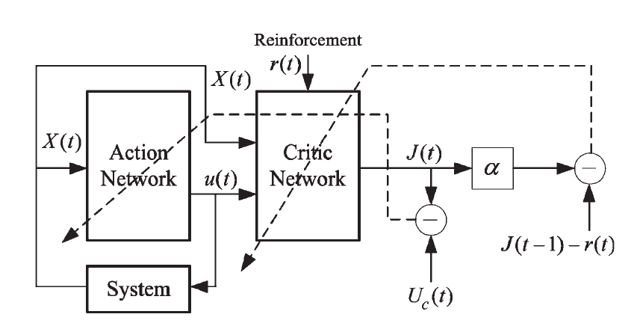
Approximate Dynamic Programming (ADP)
Schematic for implementation of Direct Heuristic Dynamic Programming (HDP).
Model Independent.
Complex, Continuous State/Control MIMO Non-Linear System with Uncertainty.
Good for Low Frequency Oscillation Problem because swing period long enough to provide sufficient time for controller to learn and adapt.

Slide 4
Online Learning Control by Association and Reinforcement
IEEE Transactions on Neural Networks (2001)
Jennie Si and Yu-Tsung Wang
Among the various algorithms of Adaptive Critic Designs, a specific system architecture called
Action Dependent Heuristic Dynamic Programming (ADHDP)
for online learning control is proposed and demonstrated in this paper.
Here onward, all these algorithms will be only called as ‘Dynamic Programming’.

Slide 5
Motivation behind Heuristic Dynamic Programming
Domain: A class of learning decision and control problems where the environment/system that interacts with the ‘learner’ is NOT known beforehand.
Problem = Maintaining Stable Operation in Environment = Power Distribution Systems
Environment: The environment can be Stochastic, Non-Linear and Subject to change over time.
Powerflow is Non-Linear. Loads are Stochastic, Network could trip leading to topology changes, Extreme weather could block your generation.
Problem Statement: Devise a control learning algorithm which optimizes some sort of figure of merit over time.
Merit could be minimizing deviations from grid frequency and voltage dip.

Slide 6
Motivation behind Heuristic Dynamic Programming
Learning Timeline: ‘On-the-fly’ i.e. Online learning during interaction with the environment itself.
Learning Outcome: While measurements from the environment are available from one decision and control step to the next, a final outcome of the learning process from a generated sequence of decisions and controls may come as a delayed signal in only an indicative ‘win’ or ‘lose’ format.

Slide 7
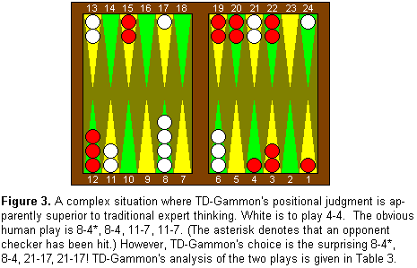
Motivation behind Heuristic Dynamic Programming
Dynamic Programming has garnered great intuitive appeal for solving such class of problems.
Noteworthy example: TD-Gammon program has learnt to play Backgammon at a grandmaster level.

Slide 8
Motivation behind Heuristic Dynamic Programming
Dynamic Programming (via Reinforcement Learning) excels in Markovian Environments compared to traditional Supervised and Unsupervised Machine Learning Algorithms.
Markovian Environment: An environment where a system’s next state is dependent on the current control step as well as the previous N states of the system.

Slide 9
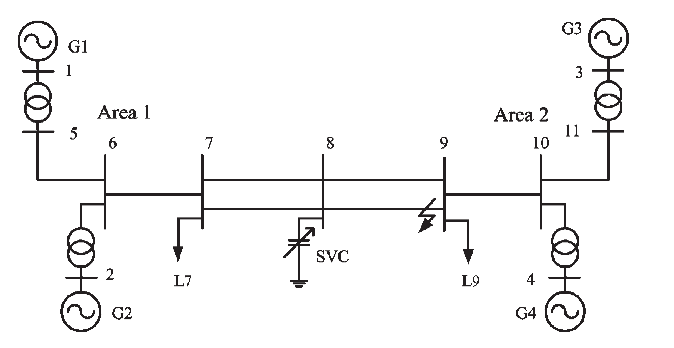
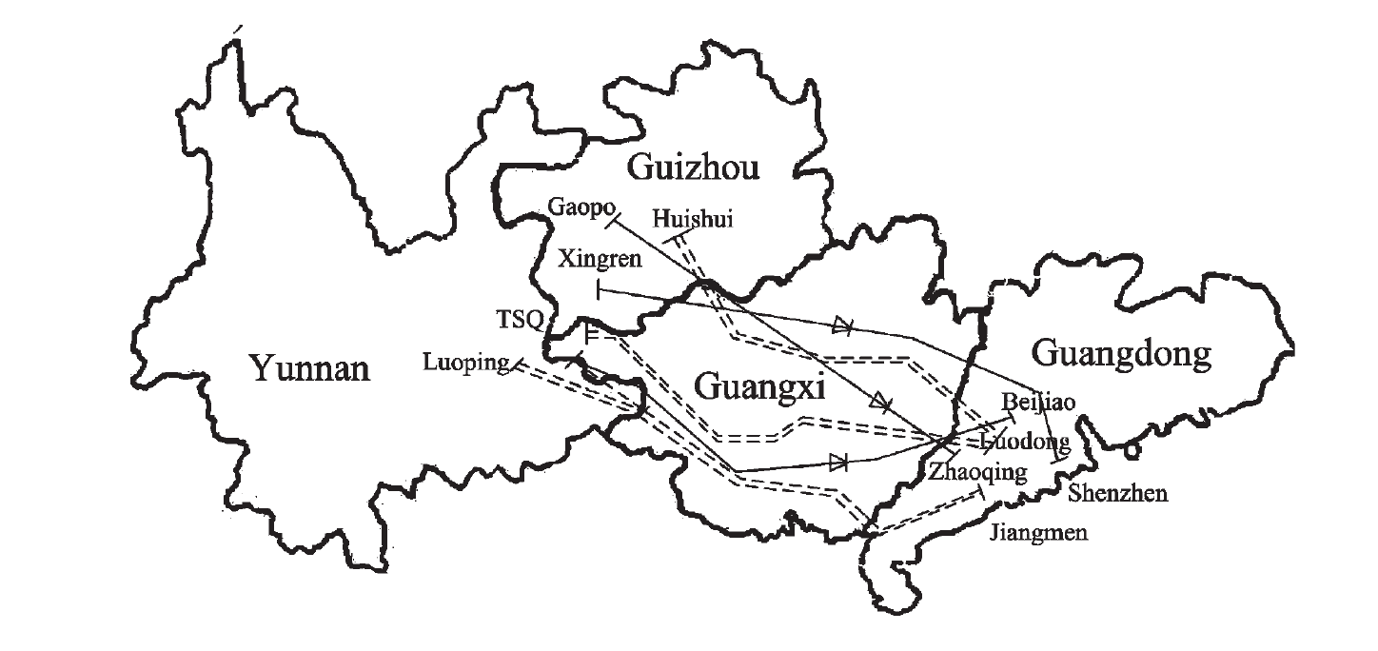
Systems Tested
Kundur 4 Machine 2 Area (4M2A) system.
China Southern Power Grid (CSG)

Slide 10
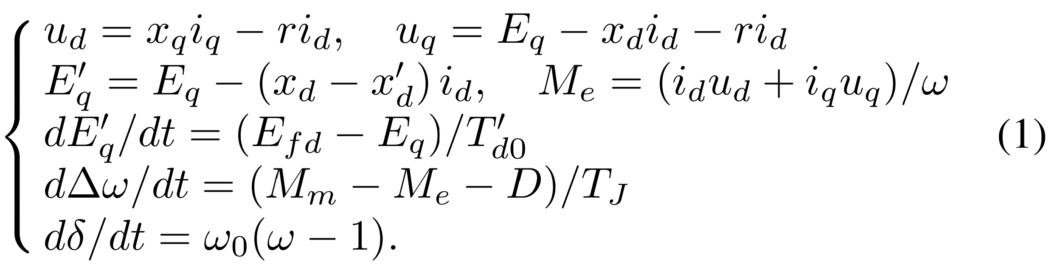
Machine Model Used by the Authors
Type 2 and One-Axis Model

Slide 11
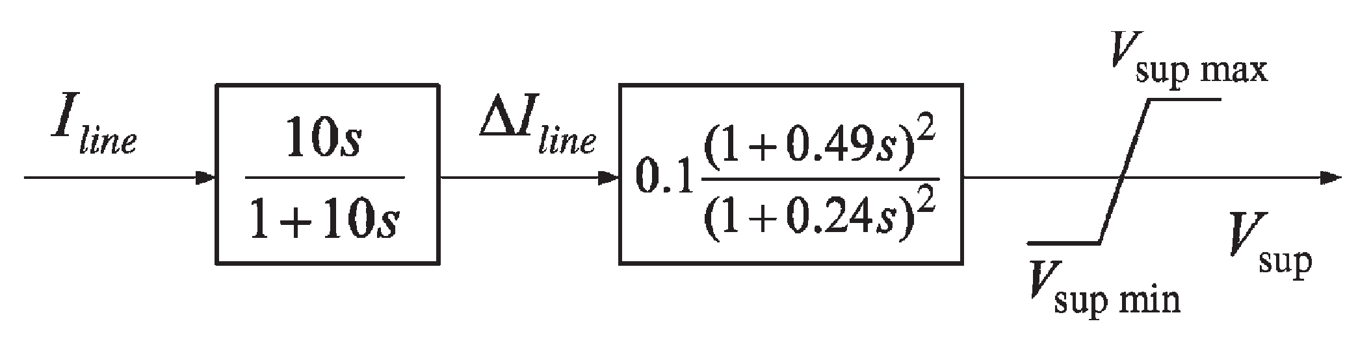
Conventional Supplementary Controller
Conventional Supplementary Controller uses Inter-area line current as its only input.

Slide 12
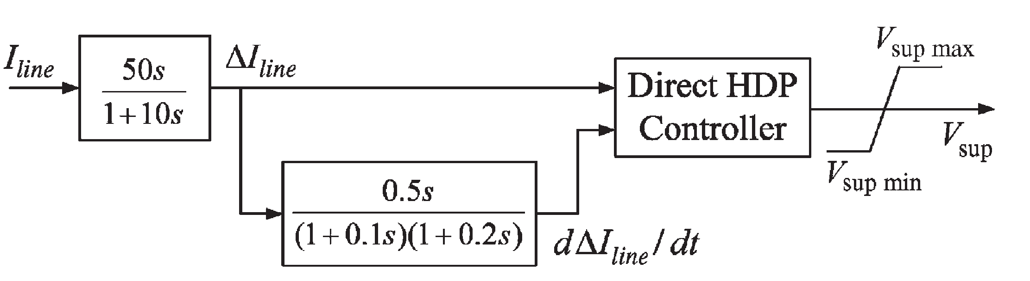
Proposed Supplementary Controller using Dynamic Programming
The action and critic networks are only using a small number of hidden layer neurons. So in order to better suppress the generator inter-area oscillation swings, apart from the inter-area line current, its derivative was also used as an input.

Slide 13
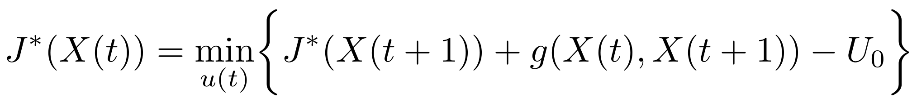
Online Learning Control by Association and Reinforcement
IEEE Transactions on Neural Networks (2001)
Jennie Si and Yu-Tsung Wang
A Critic network ‘critiques’ the generated action value in order to optimize a future ‘reward-to-go’ by propagating a temporal difference between consecutive estimates from the critic/prediction network.
The Bellman Equation

Slide 14
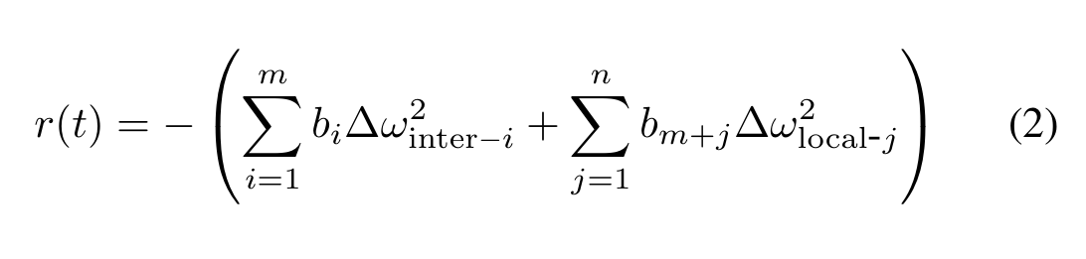
Approximate Dynamic Programming (ADP)
Schematic for implementation of Direct Heuristic Dynamic Programming (HDP).
The Cost Function is the only feedback to the controller on its performance.
All controllers controlled using the same (unified) cost function.
The difference in rotor speeds for inter-area oscillations is a sensible choice for reinforcement signal.

Slide 15
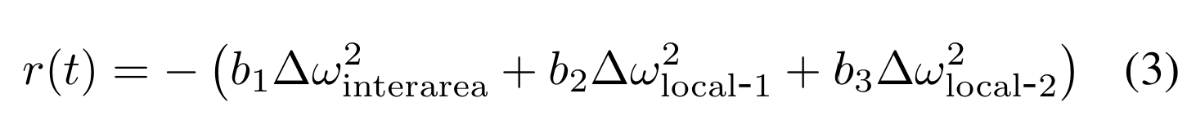
Approximate Dynamic Programming (ADP)
Schematic for implementation of Direct Heuristic Dynamic Programming (HDP).
Action and Critic Networks are modelled using a single hidden layer Neural Network.

Slide 16
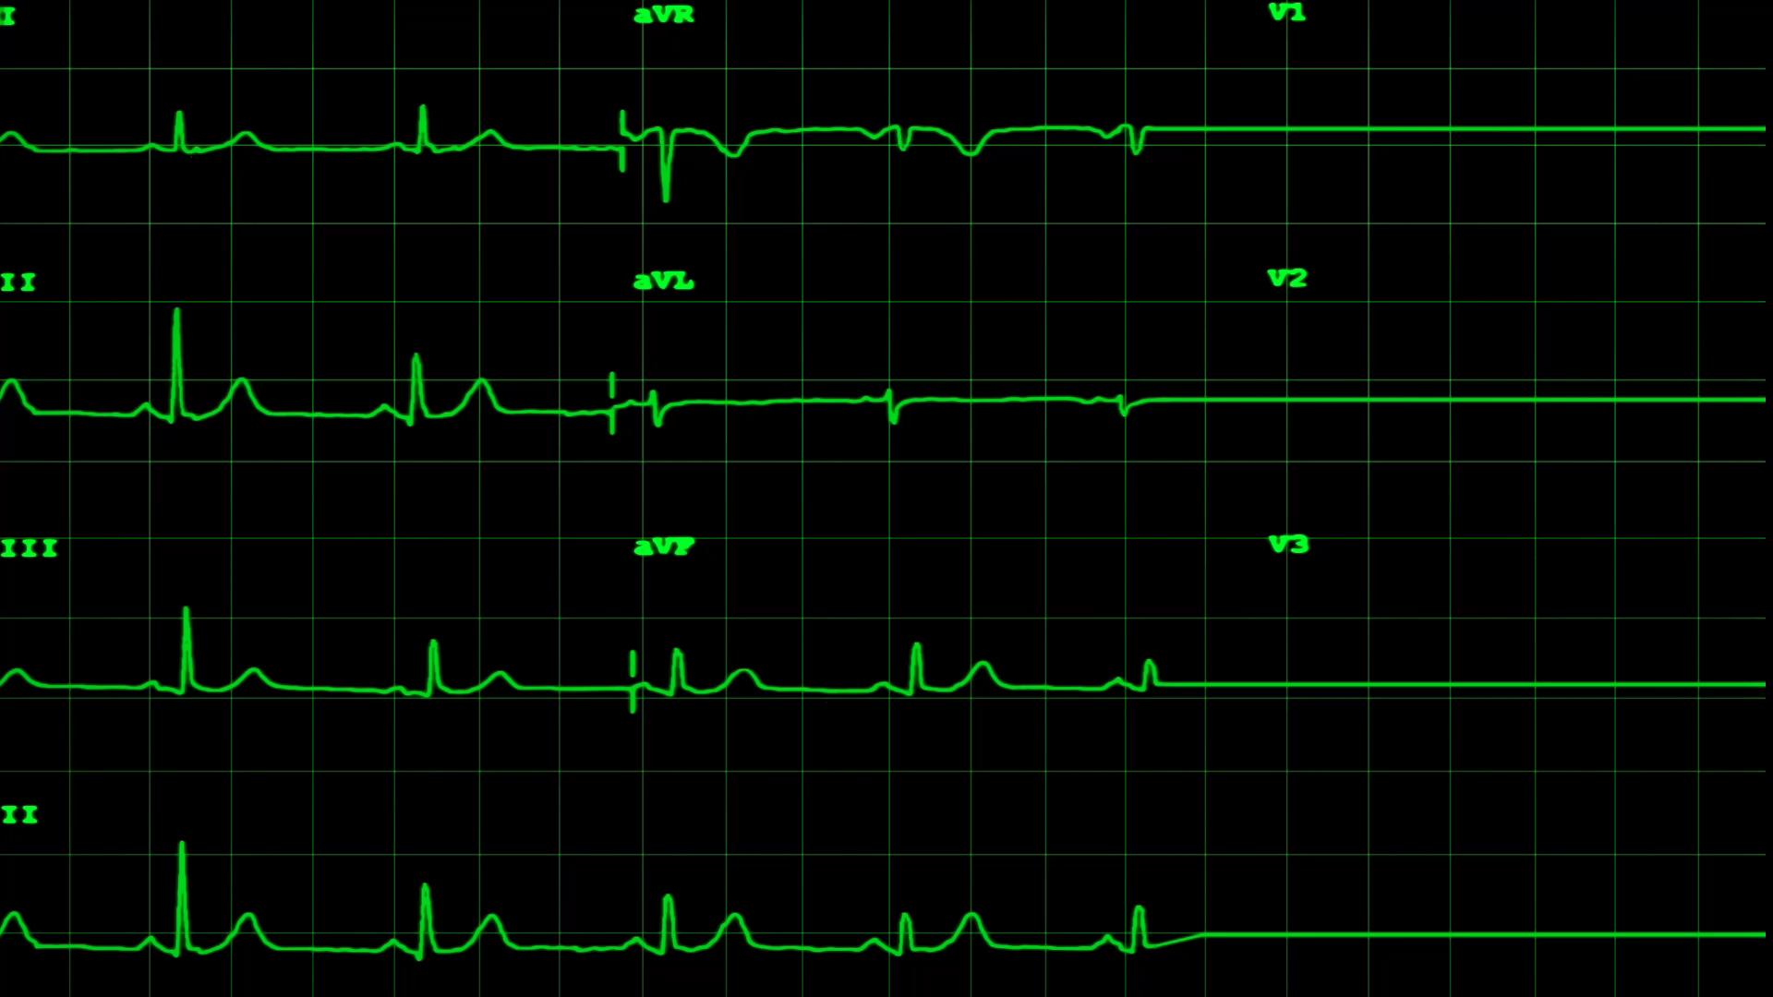
Case Study: Short Circuit Fault Occurred on the inter-area line between buses 7 and 8. Fault Cleared after 74 ms.

Slide 17
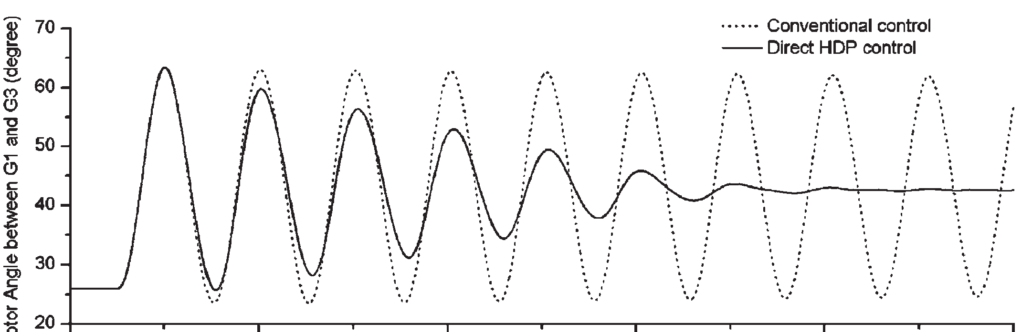
Simulation Results and Comparison between Dynamic Programming Method and Conventional Method for Damping Inter-area Oscillations
Rotor Angle difference between Generators 1 (Area 1) and Generator 3 (Area 2) damped after clearing the fault, whereas the conventional supplementary controller couldn’t stabilize the network after the fault.
Similarly, for the CSG, the study conducted on two generators (Qiangxi and SJCG) yielded the same outcome.

Slide 18

Project Objectives
Implement both the proposed supplementary controller and the conventional supplementary controller on the inter-area line.
Perform transient simulation and cross-check the results.
How are the damping values for small-signal stability affected for different modes and machines?

Slide 19
References
Lu, C., Si, J., & Xie, X. (2008). Direct Heuristic Dynamic Programming for Damping Oscillations in a Large Power System. IEEE Trans. Syst. Man Cybern. Part B Cybern., 38(4), 1008–1013. doi: 10.1109/TSMCB.2008.923157
Si, J., & Wang, Y.-T. (2001). Online learning control by association and reinforcement. IEEE Trans. Neural Networks, 12(2), 264–276. doi: 10.1109/72.914523

